Slide 1


Welcome…
a few things to note before we begin:
Grab a handout
We are having a Post-Secondary Fair on Nov 3rd →
If you are an SHSM students, attending this session counts as a Reach Ahead (you will need to self-report using the Google Form on the Google Classroom
This will be shared on the Maple Grads Google Classroom

Slide 2
Ontario College Application User Guide
2022 / 2023
ontariocolleges.ca

Slide 3
Research Colleges and Programs

Slide 4

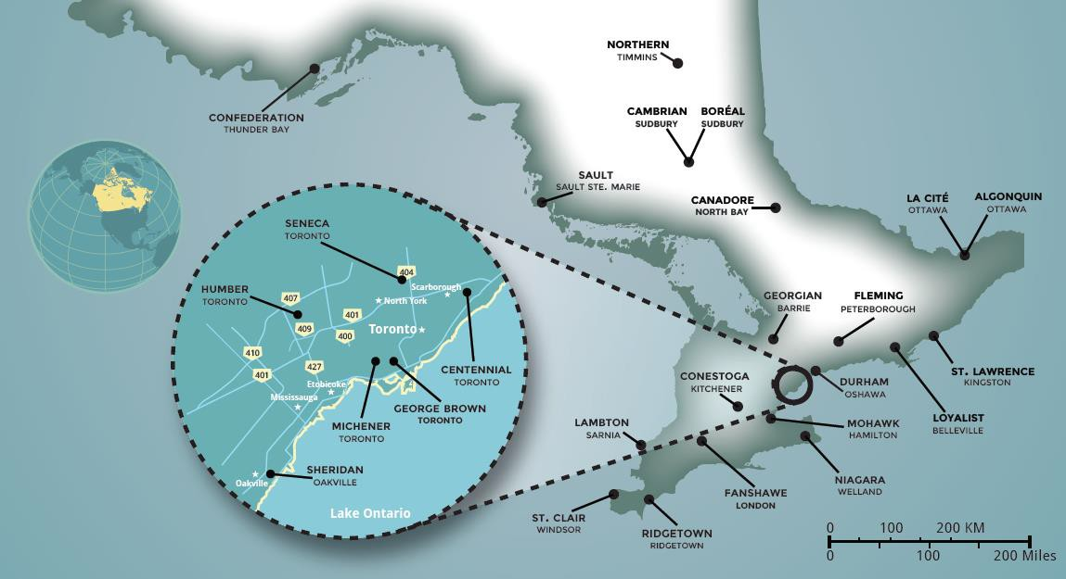
Visit ontariocolleges.ca/map for all campus locations

Slide 5
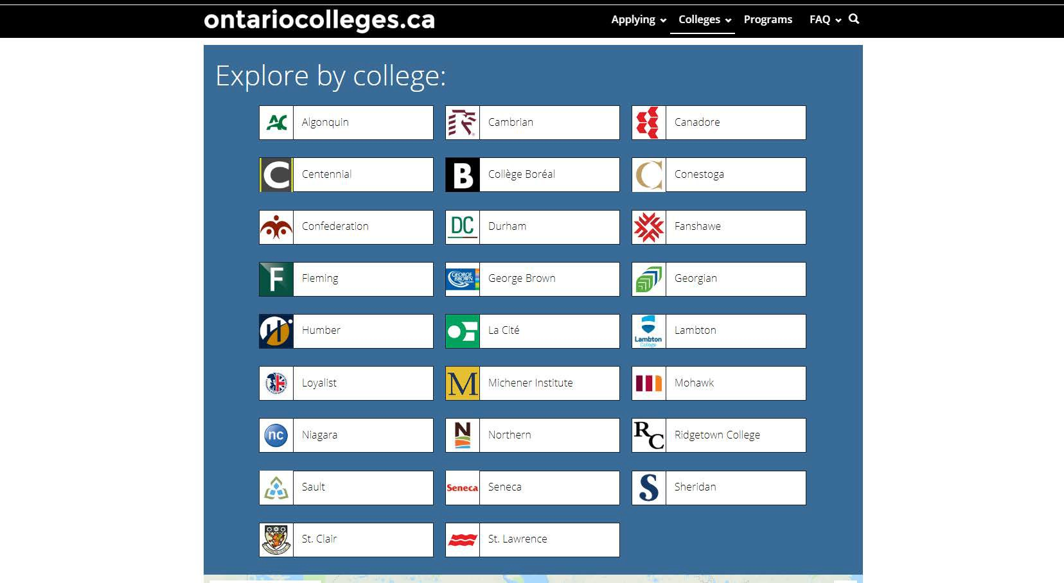
Explore Colleges
Go to ontariocolleges.ca/colleges
Click any college name to start exploring.

Slide 6

Explore Colleges
Learn more about the college, its programs and student life.

Slide 7
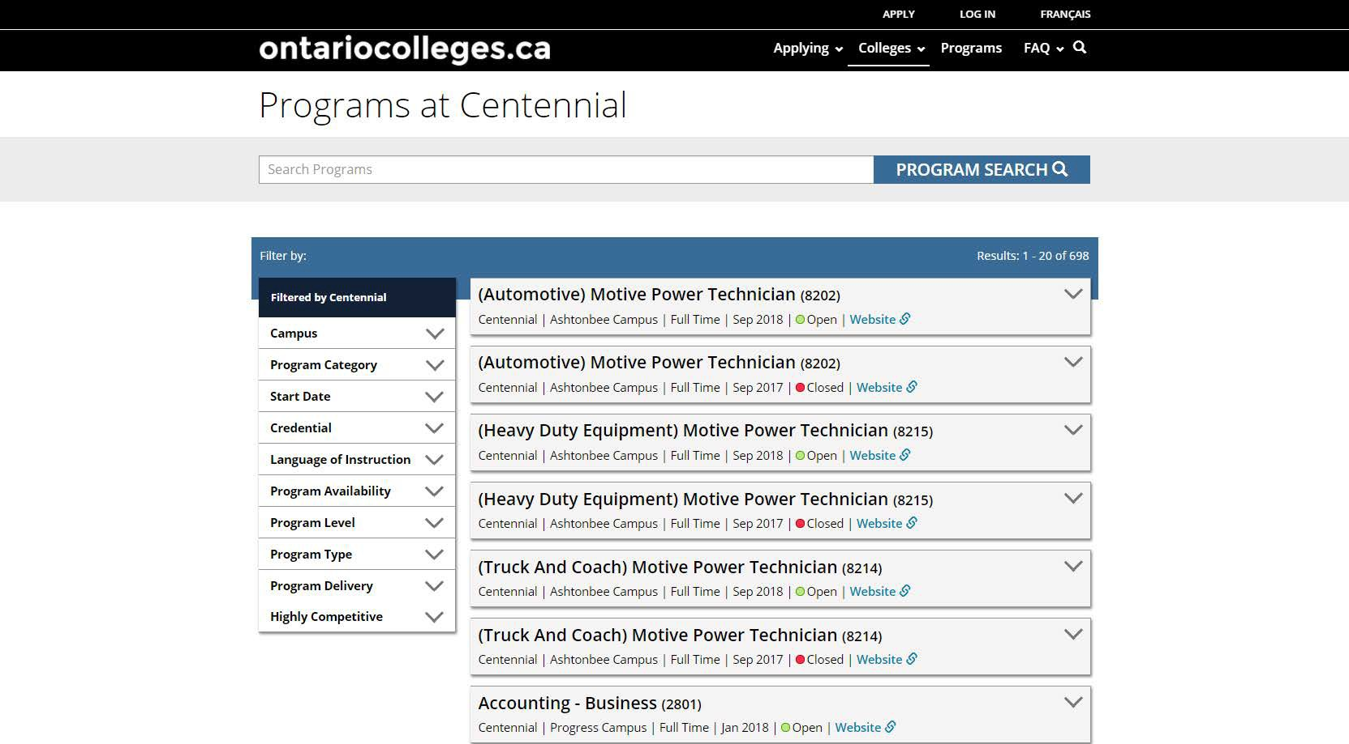
Explore Colleges
Programs
Searchable list of all programs offered by the college.

Slide 8
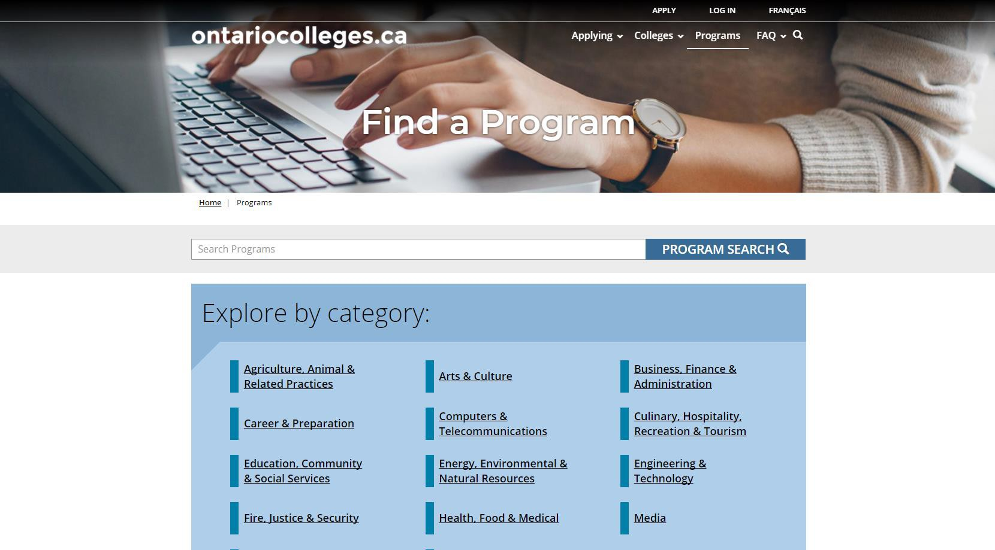
Search for Programs
Go to ontariocolleges.ca/find
Search by keyword
Search by category

Slide 9
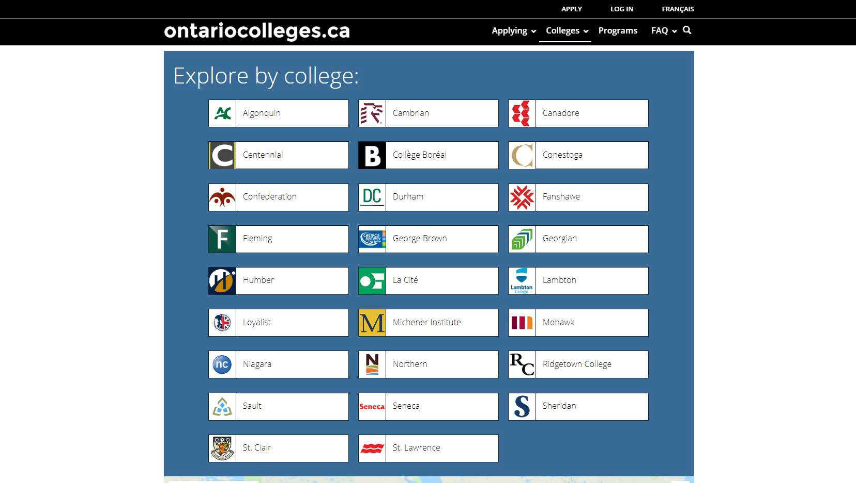
Search for Programs
Go to ontariocolleges.ca/find
Search by college

Slide 10
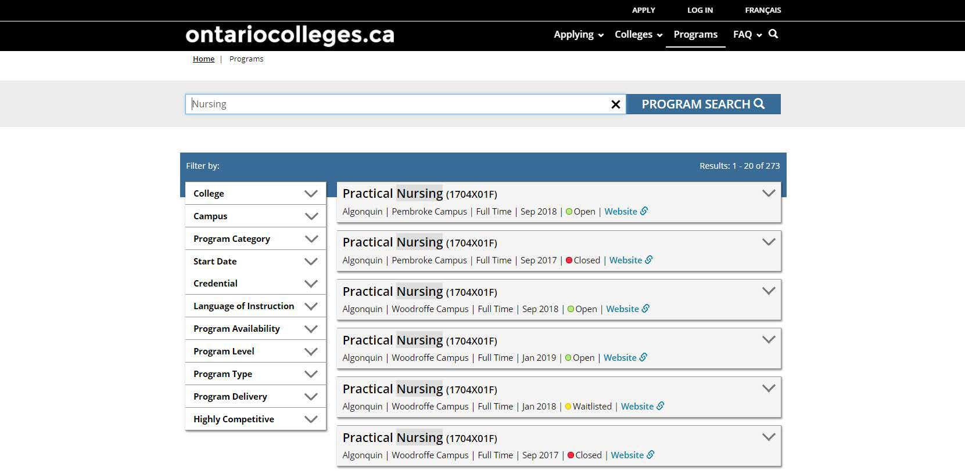
Search for Programs
Refine Your Search
Refine your search results by College, Campus, Program Category, Start Date, Credential, Highly Competitive and more.

Slide 11
Attend College Events
Maple High School Post-Secondary Pathways Fair
November 3rd 7pm-9pm
Central Region Colleges Virtual Panels
Representatives from Centennial, George Brown, Georgian, Humber, Seneca, and Sheridan
Wed. November 16th 2:00pm - 3:00pm
Wed. December 7th 6:00pm - 7:00pm
Ontario College Information Fair (OCIF)
The Ontario College Fair will happen on October 19-20 this Fall. For more info, visit ocif.ca.
College Open Houses
The colleges host Open House events every fall and spring. To find out when they’re happening, check out the Maple Grads 2023 Google Classroom.

Slide 12
Prepare To Apply
NOTE: These instructions are for domestic applications (Canadian Citizens and Permanent residents). If you are an International Student or Convention Refugee, you will need to apply to each school separately. We have posted instructions to the 5 GTA schools on our Maple High School Guidance Webpage to help you. If you have questions, please contact you guidance counsellor.

Slide 13
Important Dates
Early October 2022: Online Application Opens
2022 / 2023 application opens at ontariocolleges.ca.
November 1, 2022: Earliest Offer Date for non-competitive programs
November 1st is the first day that colleges may begin sending offers of admission.
February 1, 2023: Equal Consideration Date
Applications received and paid for on or before this date are considered equally by the colleges. It is critical to apply to highly competitive programs by this date. Applications are still processed after this date, but are considered on a first-come, first-served basis by the colleges.
February 1, 2023: Earliest Offer Date for competitive programs
February 1st is also the first day that colleges may begin sending offers of admission. Colleges continue to offer admissions until programs are filled.
May 1, 2023: Confirmation Deadline
Most offers of admission must be confirmed by this date. The colleges will determine the due date to confirm offers made after May 1. Check your offer package to find out the expiry date of your offer of admission.
Mid-June 2023: Tuition Deposit Due
The colleges require payment of a tuition deposit in mid-June to secure your spot in your program. Each college sets its own tuition deposit amount and payment deadline. This information will be communicated to you by the college.
* Please note that the above dates apply to programs beginning in the fall of 2023. Contact the colleges for deadlines for other start dates.

Slide 14
Important Info About the Application
The application processing fee is $110 (non-refundable).
There may be additional fees to order transcripts.
An application allows you up to 5 program choices, with no more than 3 at any one college.
All program choices must start within the same academic year (August – July).
Your username is permanent. It will not change if you update your contact email address.
Your password must be between 8 and 14 characters in length.
DO NOT create more than one account.
Some information will be automatically added to your account based on the information you provided when creating your account.
You cannot change your first name, last name, date of birth, OEN number or academic data. To make changes to your personal information, contact ontariocolleges.ca. If there are problems with your grades, talk to your guidance counsellor.
The online application works best in the following browsers: Internet Explorer 9, 10 & 11, Firefox latest
version, Chrome latest version, Safari 7+ & iOS 7+.
The ontariocolleges.ca mobile app works best on Android and iOS smartphones.

Slide 15
Important Info About the Application
Email Address
Provide a valid email address
ontariocolleges.ca uses email to communicate important information about your application, account activation, and username / password recovery.
The colleges use email to communicate with you about your application and offers of admission.
Update your email address in the Contact Information section of the online application if it changes.
Check your email regularly
Check your junk / spam folder.
Add noreply@ontariocolleges.ca to your safe senders list.
Privacy Statement
Review our complete Privacy Statement
It explains how we use the information provided as part of your college application.
A link to the Privacy Statement is located in the footer of the ontariocolleges.ca website and within the online application.

Slide 16
Your ontariocolleges.ca Account
Your ontariocolleges.ca account allows you to:
Apply to any of Ontario’s 26 public colleges.
Review and update your college application.
Request Ontario high school transcripts (from participating schools).
Note: Grades for most current high school students are sent automatically by your high school.
Request Ontario college / university transcripts.
View and accept offers of admission.
To complete your application, you’ll need:
Your complete home mailing address, including your postal code
Your Ontario Education Number (OEN) and Student Number, found on your high school report card or transcript

Slide 17
Create an Account
Go to the ontariocolleges.ca website
New Users
If you’ve never applied through ontariocolleges.ca before, click APPLY.
Returning Users
If you have an existing account, click LOG IN.

Slide 18
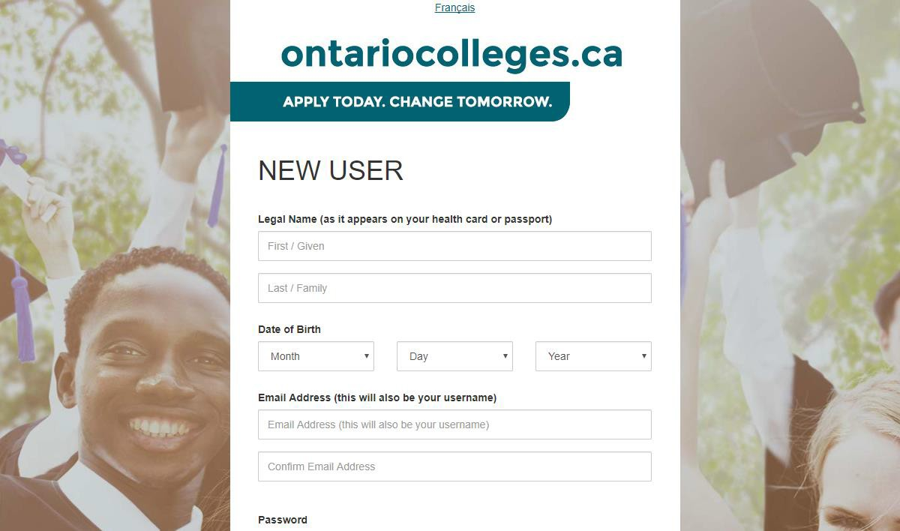
Create an Account
Fill in this information carefully.
You can only make changes to your first name, last name and date of birth by contacting ontariocolleges.ca.
Please provide a valid email address.
ontariocolleges.ca and the colleges will use it to communicate important information about your application.

Slide 19
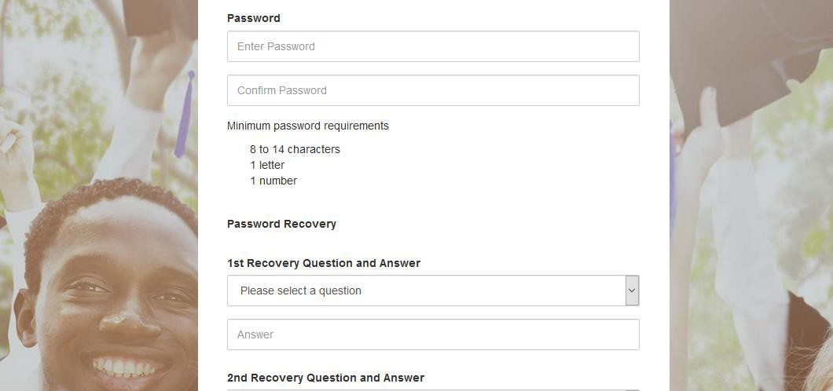
Create an Account
Password
Password Requirements
If your password does not meet the minimum requirements, you won’t be able to create an account.

Slide 20
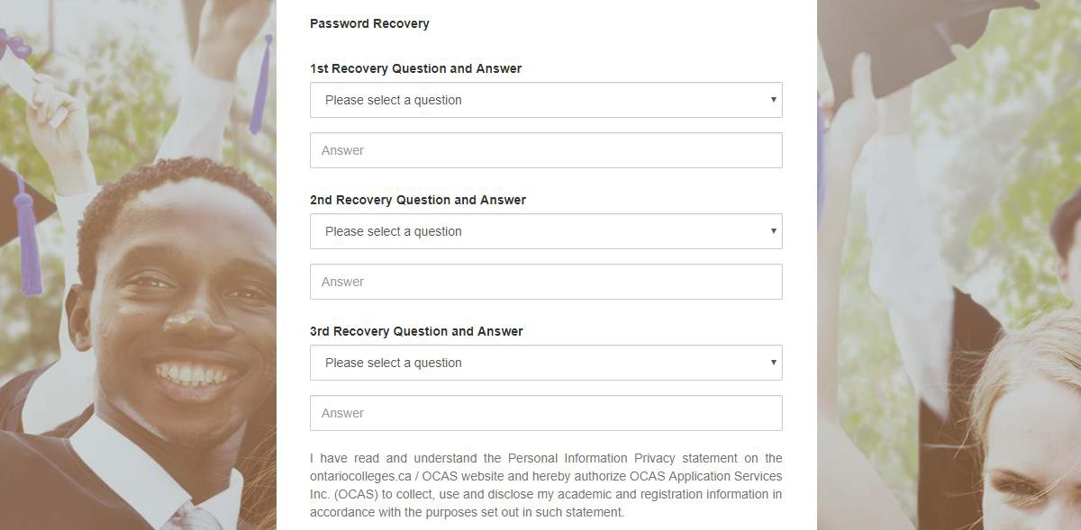
Create an Account
Password Recovery Questions
Choose questions from the list or create your own.
Make sure you choose questions and answers that you’ll remember later.
We use this information to verify your identity if you contact us for help completing your application.

Slide 21

Activate Your Account
An account activation email will be sent to the email address you entered when you created your account.
Click the link in the email to activate your account.

Slide 22

Successful Account Activation
Once your account has been activated successfully, click the button to log in to your account.

Slide 23
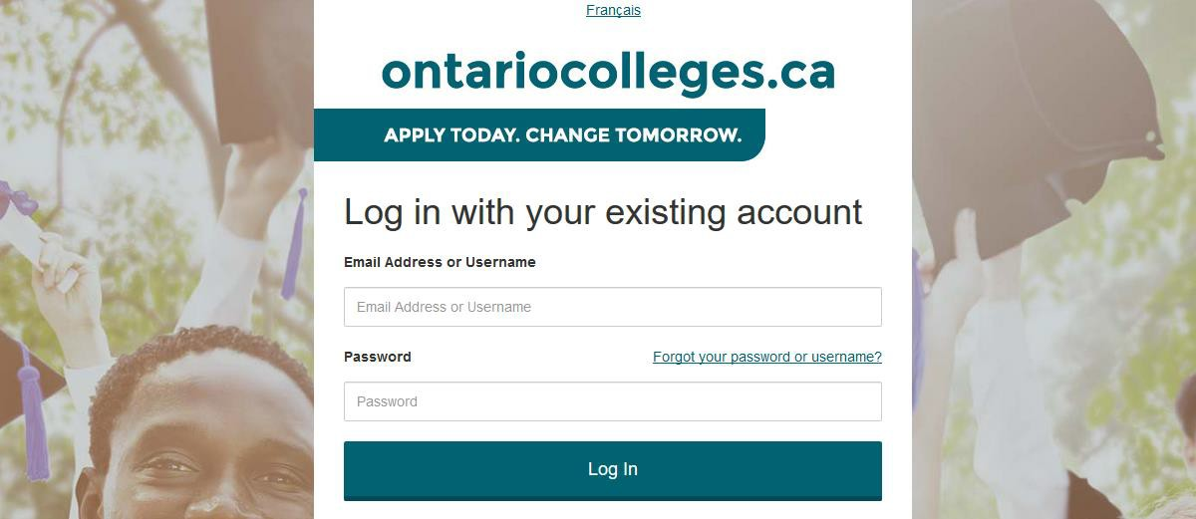
Log into Your Account
Log in using the username (your email address) and password you created during account sign up.
Forgot your username or password? Click the link to recover them.

Slide 24
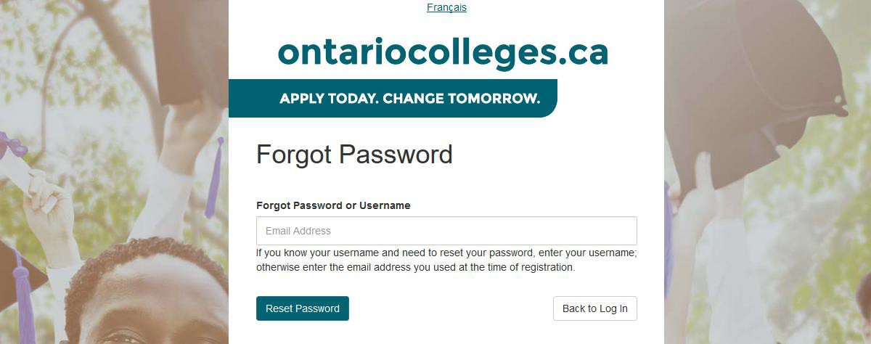
Recover Your Username or Password
Enter any email address associated with your account and click Reset Password.
An email will be sent to your contact email address containing your username and a link to reset your password.

Slide 25
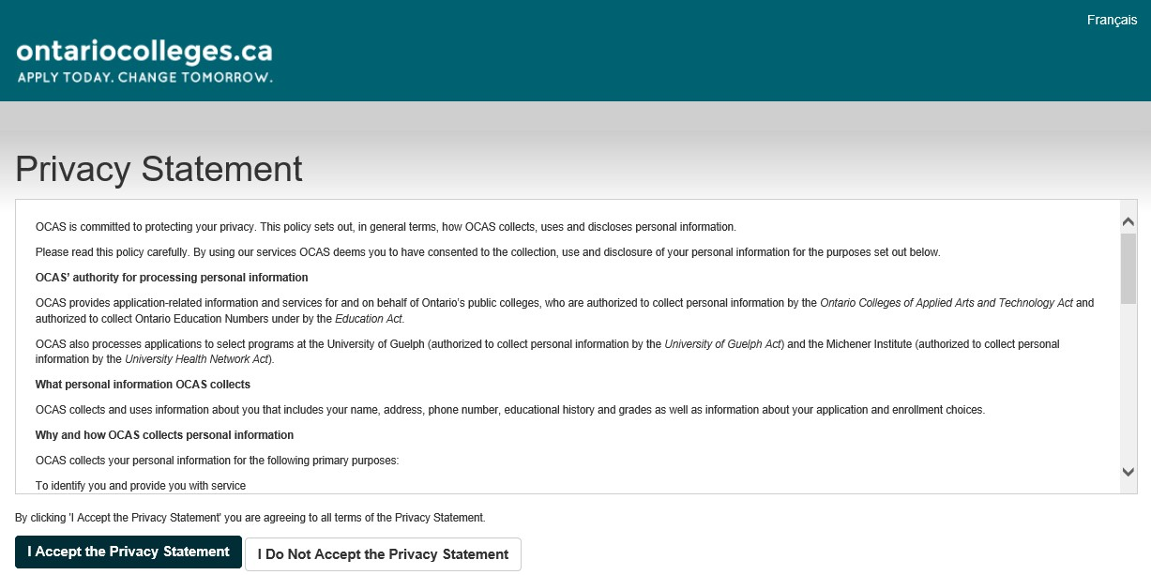
Privacy Statement
On first login only, you will be asked to review and accept our Privacy Statement.
If you do not accept the Privacy Statement, you will not be able to complete your college application.

Slide 26
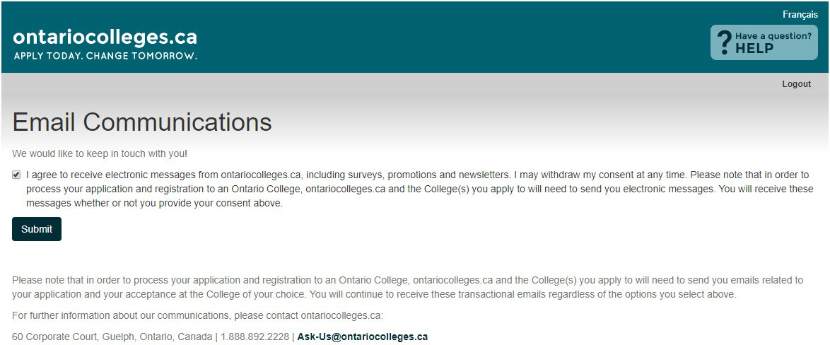
Email Communications
On first login only, you will be asked to review and accept our Email Communications.
Check the boxes to receive emails and click Submit.

Slide 27
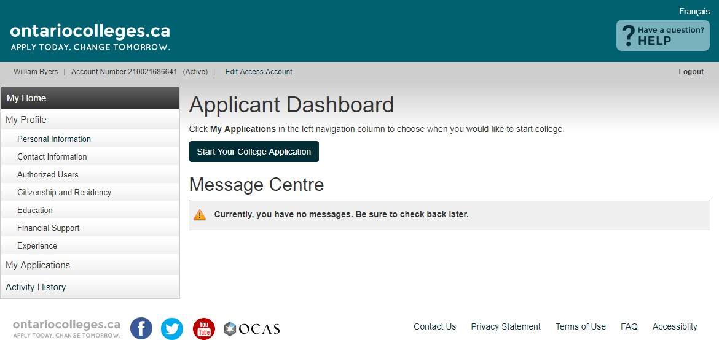
Applicant Dashboard
Start your college application from this screen.
Message Centre
Important information about your application is found here. Check regularly.

Slide 28
Applicant Dashboard
My Profile
My Profile
A checkmark will appear once each section is completed.
All sections must be completed in order when you fill out your information for the first time, even if they don’t apply to you.
Click Save and Continue to move to the next step.

Slide 29
Applicant Dashboard
My Profile
My Profile
Personal Information – Basic demographic info, including legal name, date of birth, etc.
Contact Information – Street address, email address, telephone numbers
Authorized Users – Authorization to allow another individual access to your account / application (e.g. parent, guidance counsellor) (Note: not shared with the colleges)
Citizenship and Residency – Citizenship, residency status in Canada, country of birth.
Documents related to your status in Canada will be posted here.
Education – Schools attending / attended. Grades, transcripts and supporting documents will be posted here.
Financial Support – Agency sponsorship; this does not include OSAP
Experience – Add employment or volunteer experience that relates to your area of
study. Test results and other supporting documents will be posted here.

Slide 30
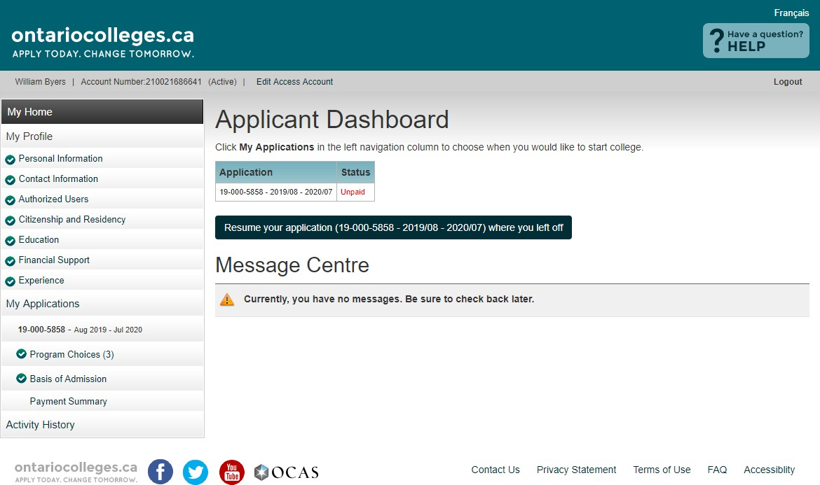

Applicant Dashboard
My Applications
My Applications
Program Choices – select or update your program choices in this section
Basis of Admission – identify if you are / will be a high school graduate or enrolled in a high school course
Payment Summary – listing of fees requiring payment
Activity History
Summary of application’s day-to-day activities

Slide 31
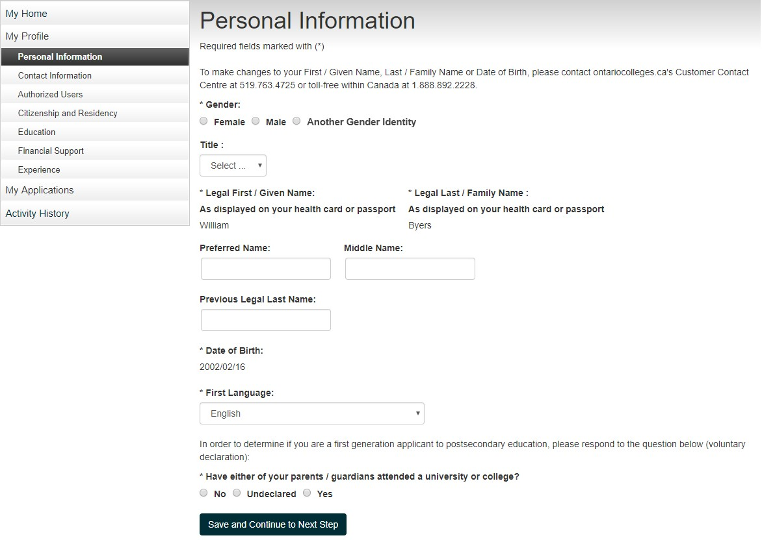
Personal Information
Complete all required fields (marked with *).
Click Save and Continue to Next Step.

Slide 32
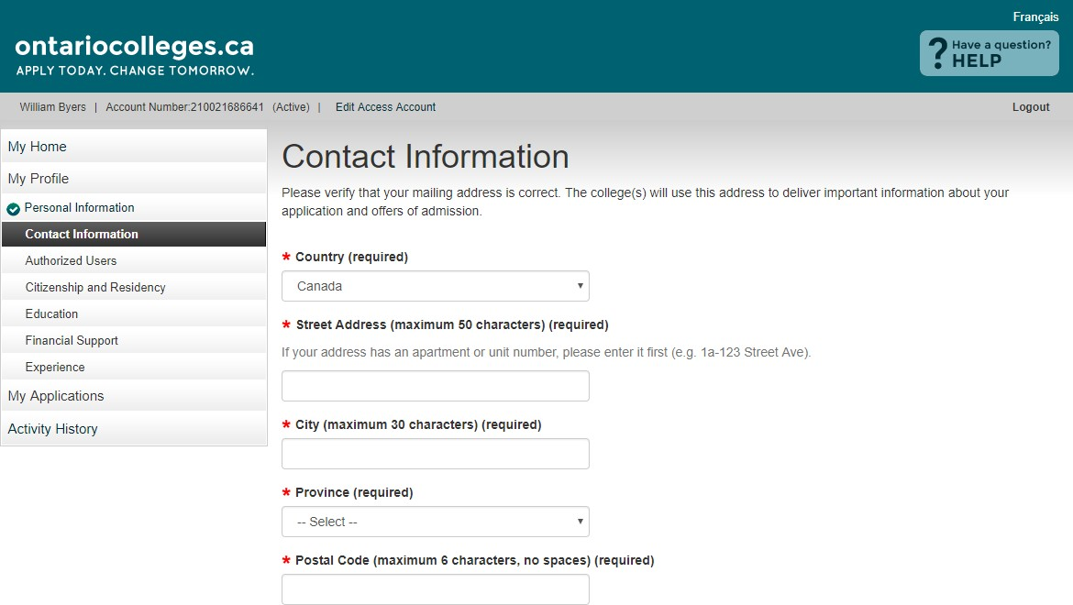
Contact Information
Mailing Address
Start typing your mailing address and select it from the list.
If your address isn’t in the list, you
can enter it manually.

Slide 33
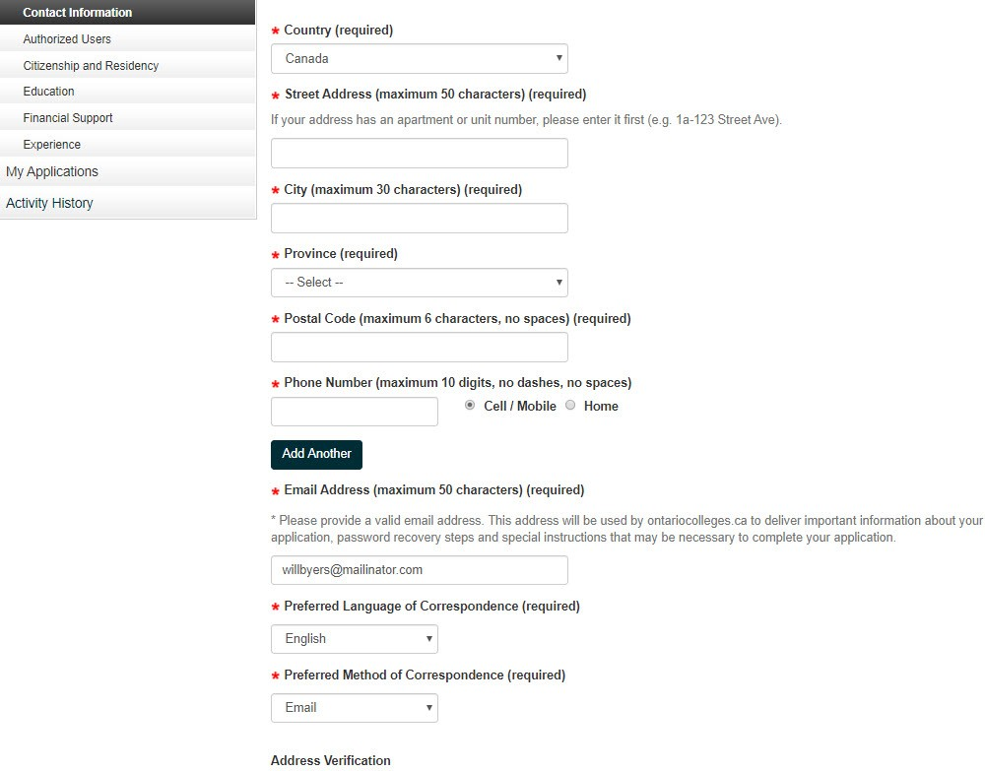
Contact Information
Complete the remaining fields.

Slide 34
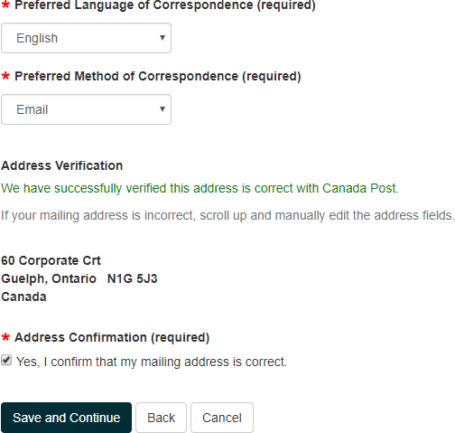
Contact Information
Address Verification
Click the checkbox to confirm that
your mailing address is correct.
Click Save and Continue.

Slide 35
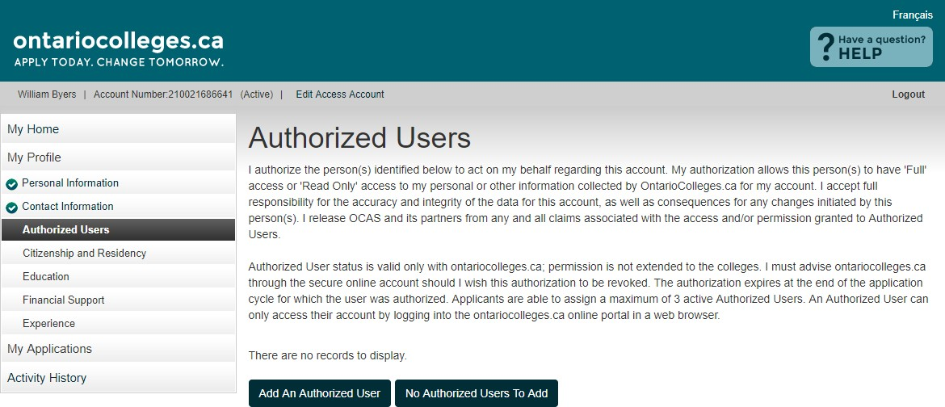
Authorized Users
Authorized Users
Authorize another individual access to your account / application
Maximum of 3 individuals at one time
Authorization can be added, changed or revoked at any time
All actions made by authorized individuals appear in Activity History
Access does not extend to your file at the college(s)
If you do not wish to give anyone permission to access your account, click No Authorized Users to Add.

Slide 36
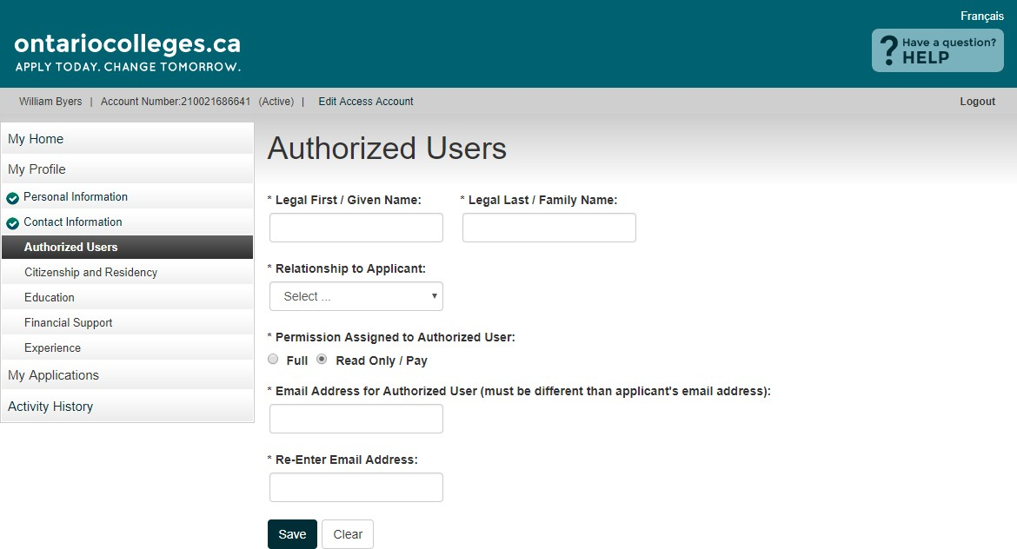
Authorized Users
Add an Authorized User
Permission Assigned to Authorized User
Full – Authorized individuals can make payments and changes to your application information only. They cannot access offers of admission or reset your password.
Read Only / Pay – Authorized individuals can make payments and ONLY VIEW your application information.
Complete required fields. Click Save.

Slide 37
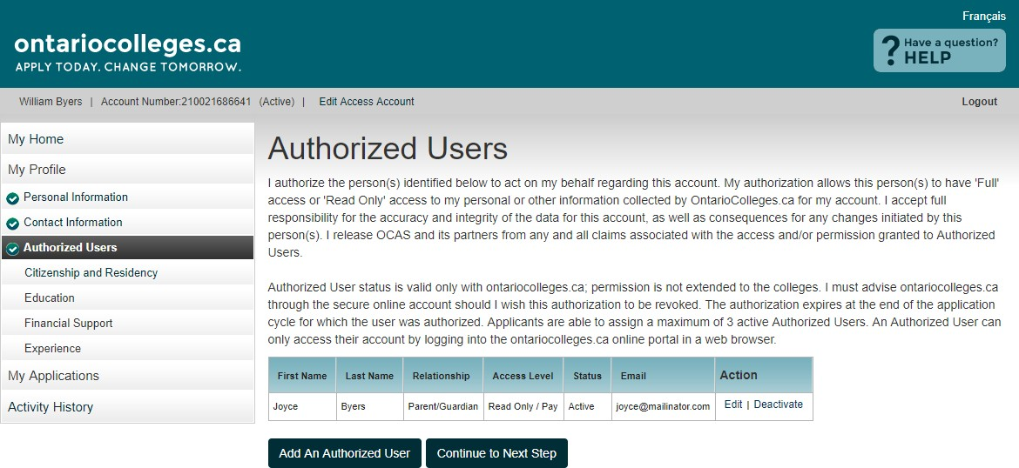
Authorized Users
Summary
Authorized individuals, once added, receive account activation emails and are asked to create their own unique usernames and passwords to access your account.
Authorization can be added, changed or revoked at any time using the Edit and Deactivate links.
When you’re done adding Authorized Users, click Continue to Next Step.

Slide 38
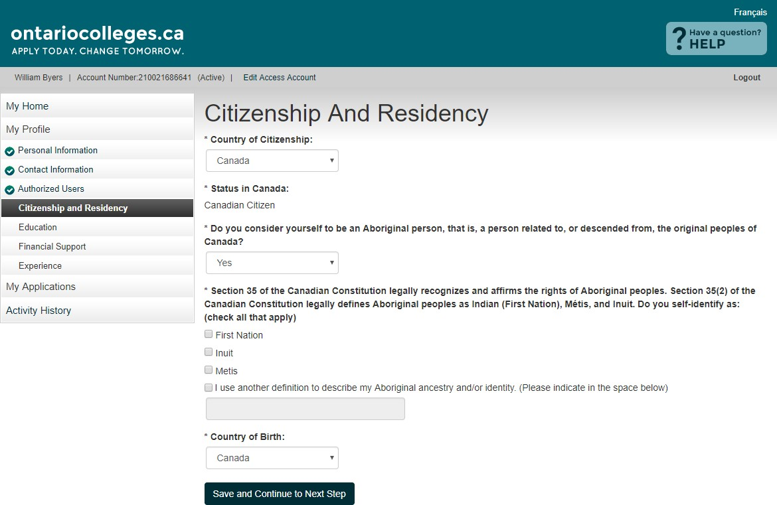
Citizenship and Residency
Canadian Citizens: Select Yes if you consider yourself to be an Aboriginal person, that is, a person related to, or descended from, the original peoples of Canada.
Indicate which definition you use to describe your Aboriginal Ancestry.
Complete the fields by selecting information from the drop-down menus.
Click Save and Continue to Next Step.
Note: Documents related to your status in Canada will be posted here when received.

Slide 39
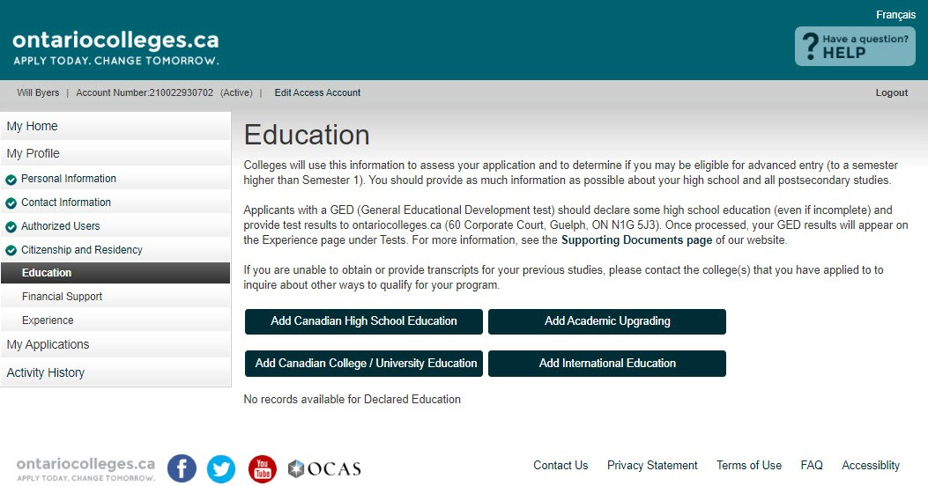
Education
Complete only the sections that
apply to your education experience.

Slide 40
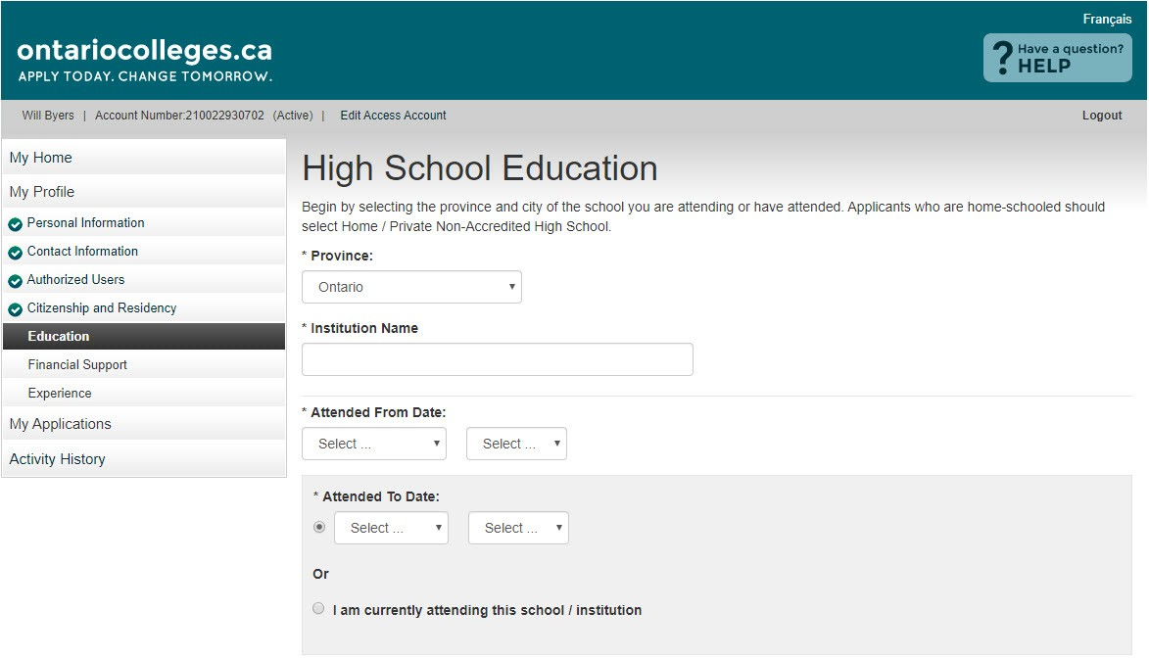
Education
Add High School Education
Ontario High School Students:
Begin typing your school name and select it from the list.
All Applicants:
Enter the date you started high school.
Graduates / Former Students:
Enter the date you completed / left high school.
Current Students:
Click the radio button.

Slide 41
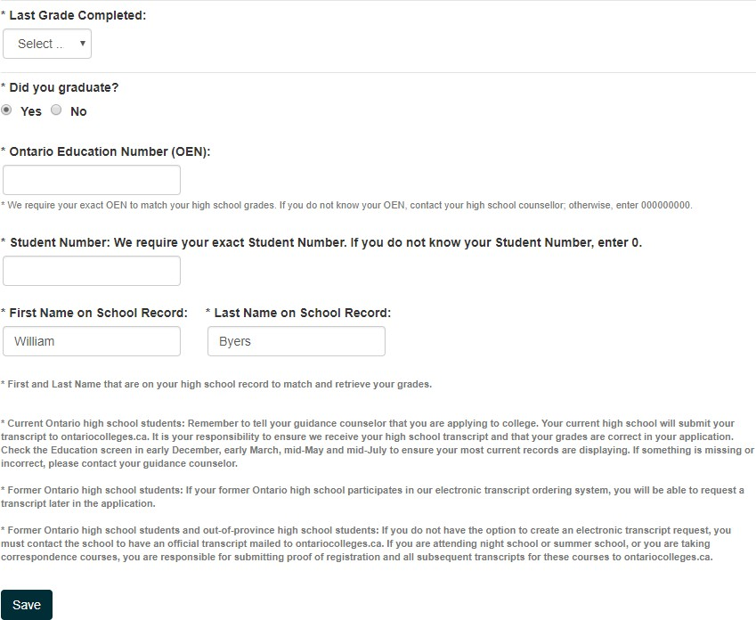
Education
Add High School Education
Current Ontario High School Students Only:
Most high schools automatically forward your grades to ontariocolleges.ca. You will need to let your guidance counsellor know that you’re applying to an Ontario college.
To allow us to match your grades to your application, your OEN number and Student Number must be accurate.
Graduates / Former Ontario High School Students Only:
Your First / Last Name on School Record must also be accurate. Click Save when done.

Slide 42
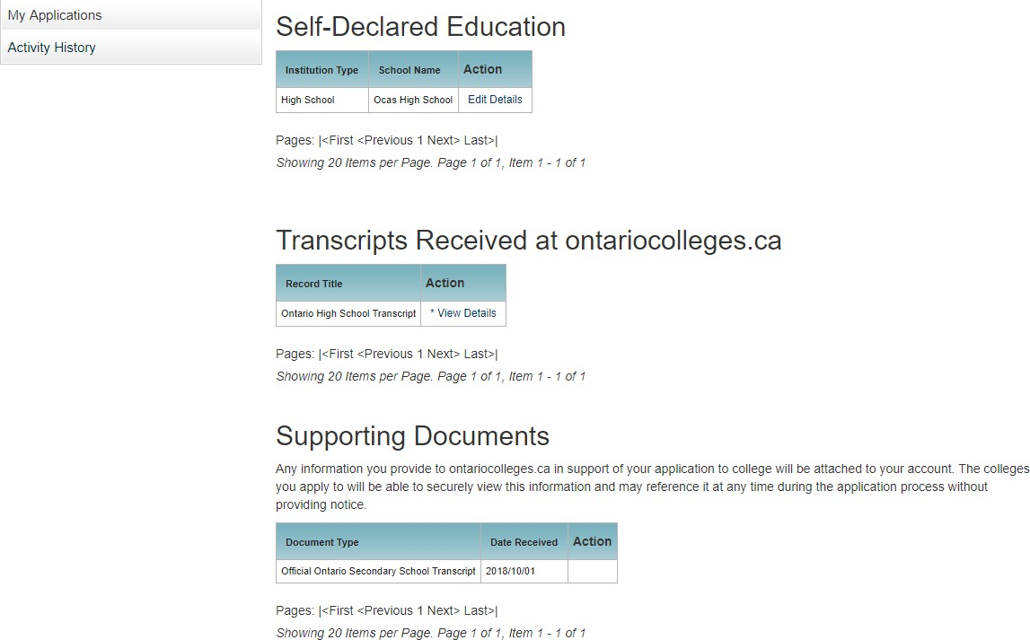
Education
Summary
You cannot delete an education record once it has been added. However, you can make changes (e.g. dates attended), if needed.
Ontario High School Grades
Grades will be listed in the Transcripts Received at
ontariocolleges.ca section.
It’s recommended that current students check their grades several times during the school year. (e.g. After mid-term and final marks for semester 1 and 2.)
Any errors should be reported to your guidance counsellor.
You can view your transcripts, report cards, or any other documents in the Supporting Documents section once they’ve been processed.

Slide 43
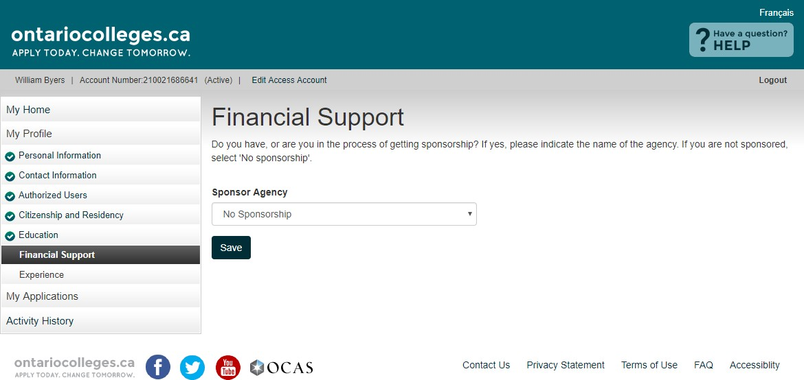
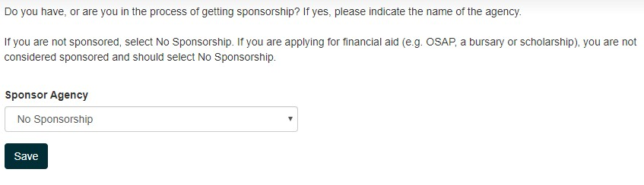
Financial Support
Sponsor Agency - The agency that will be paying all or some of your expenses while you attend college.
If you’re applying for financial aid (e.g. OSAP, a bursary or scholarship), you are not considered sponsored and should select No Sponsorship.
Click Save and Continue to Next Step.

Slide 44
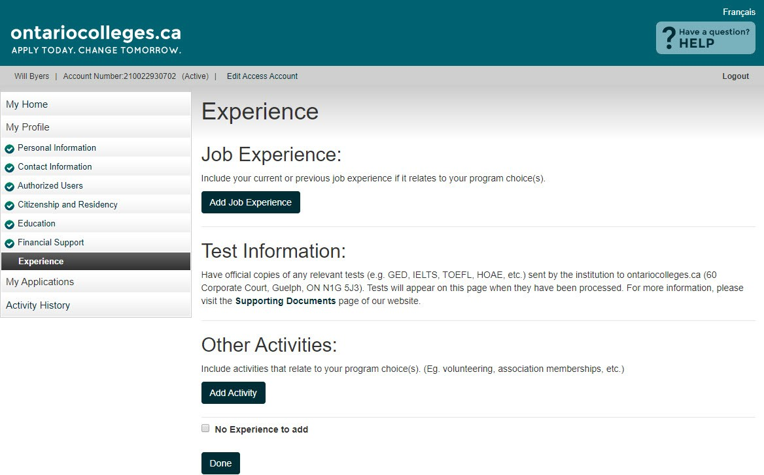
Experience
Job Experience – Previous or current paid employment
Test Information – Standardized test scores that can be submitted to support your application (e.g. GED, TOEFL, IELTS, HOAE). Your test results will be posted here once we receive them.
Other Activities – Past or current volunteer experience, associations, memberships, etc.
Only add information to these sections if it relates to your area of study. Check the No Experience to add box if none of them apply to you.
When you’re finished, click Continue to Next Step.

Slide 45
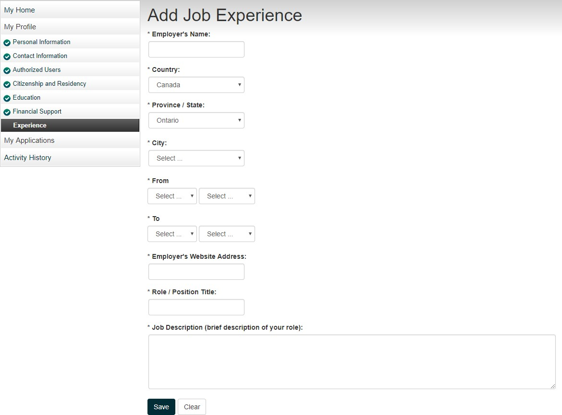
Experience
Add Job Experience
Complete all required fields. Click Save when done.

Slide 46
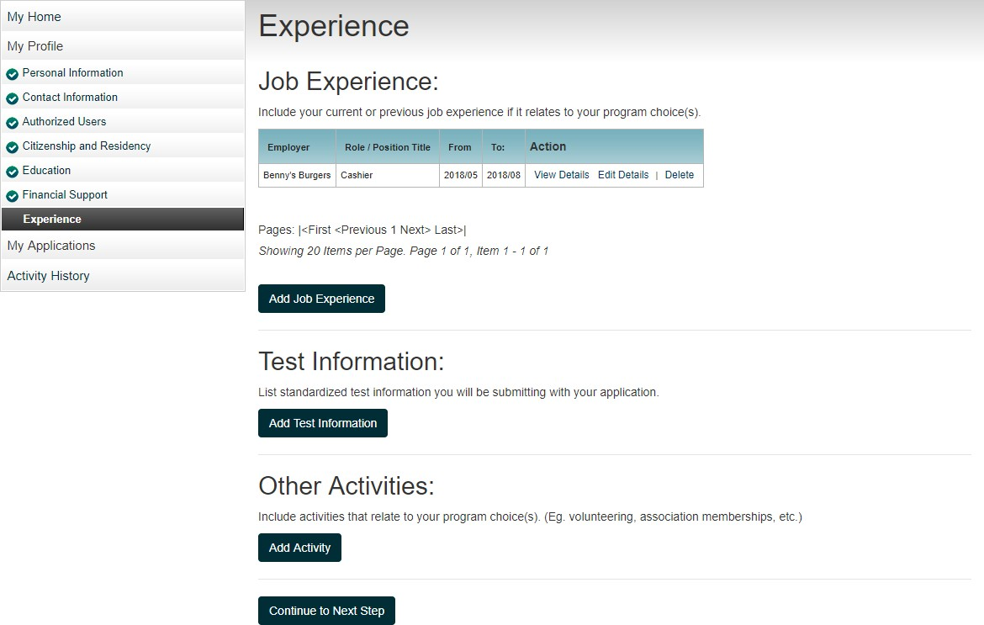
Experience
Summary
View Details – view existing information Edit Details – update existing information Delete – remove existing information
Add buttons – add
additional information

Slide 47
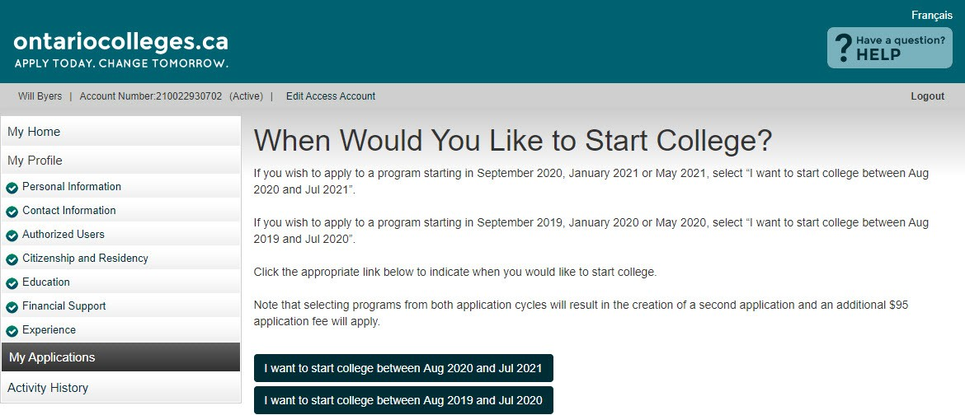
My Applications
Click the button with the start date you wish to apply to.
Selecting programs from BOTH application cycles will result in two applications and an additional application processing fee.
Note: Fees paid on duplicate applications are non-refundable.
Programs starting in:
September 2023
January 2024
May 2024

Slide 48
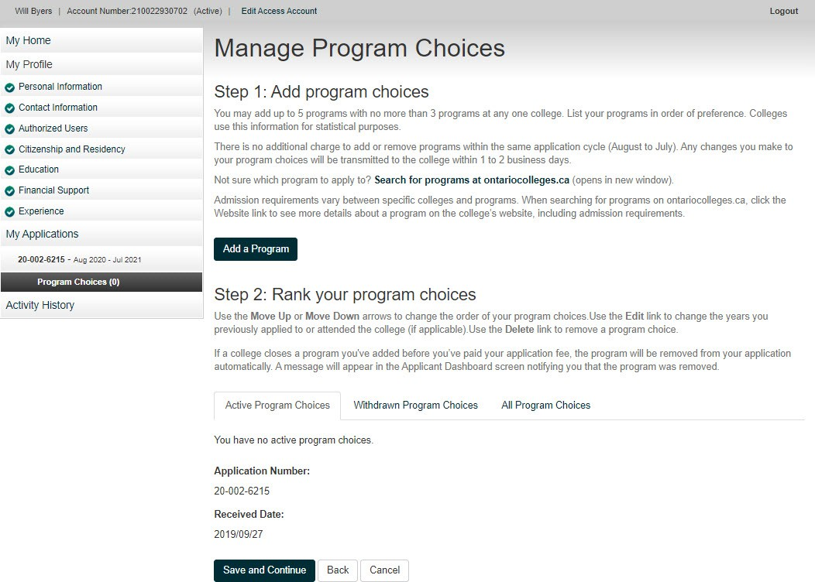
My Applications
Program Choices
Record your Account Number
Click the Add a Program button to get started.
You may apply to a maximum of FIVE program choices with no more than THREE at any one college.
You cannot create additional accounts to apply to more programs.
Record your Application Number
Received Date – the date your application fee payment is received and processed

Slide 49
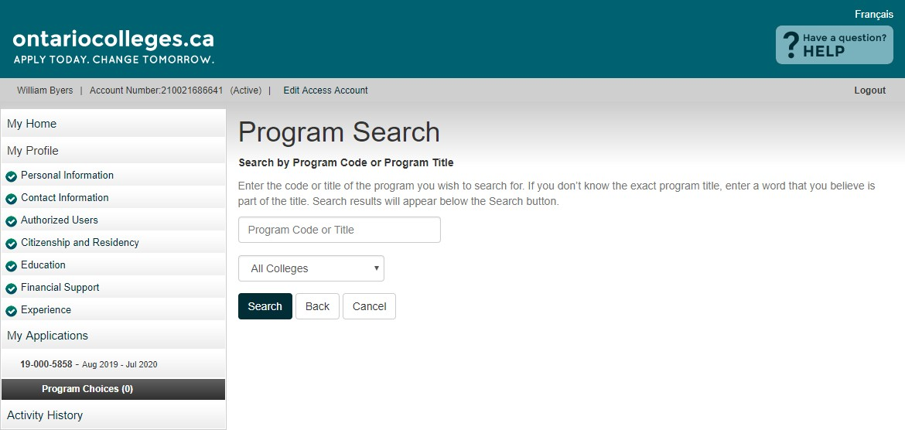
Program Choices
Program Search
Enter the code or title of the program you wish to search for.
If you don’t know the exact program title, enter a word that you believe is part of the title.
Select the college you wish to apply to or search all colleges. Click the Search button.

Slide 50
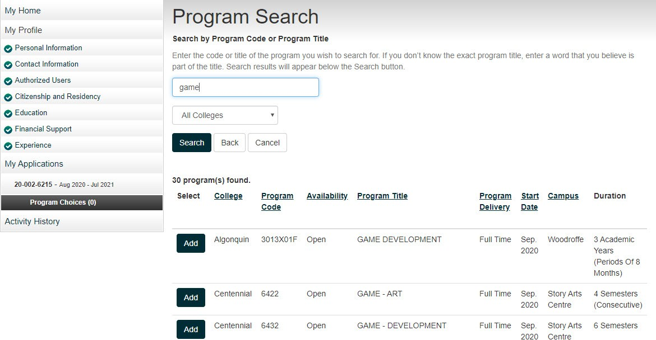
Program Choices
Program Search Results
Make sure you select the correct Program
Delivery, Start Date and Campus.
Click the Add button to add a program to your application.

Slide 51
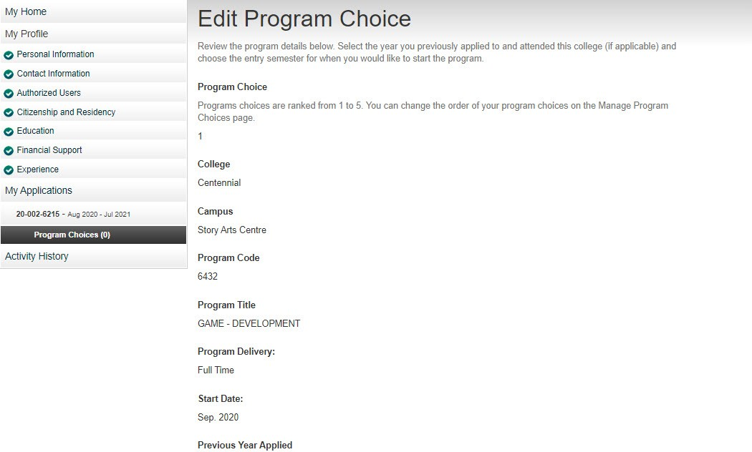
Program Choices
Edit Program Choice
Review the program details carefully to ensure you’ve selected the right program.

Slide 52
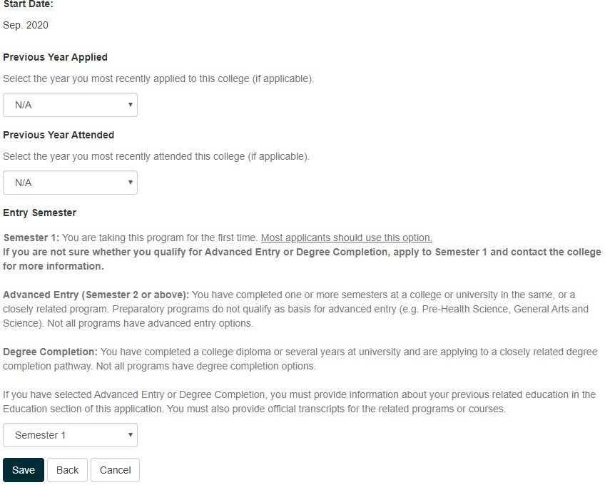
Program Choices
Edit Program Choice
Previous Year Applied
If you’ve applied to this college before, select the year.
Previous Year Attended
If you’ve attended this college
before, select the year.
Entry Semester
Entry Semester 1 is the first semester of the program’s first year.
Note: Programs with January start dates are still Entry Semester 1.
Click Save to return to the Program Choices screen.

Slide 53
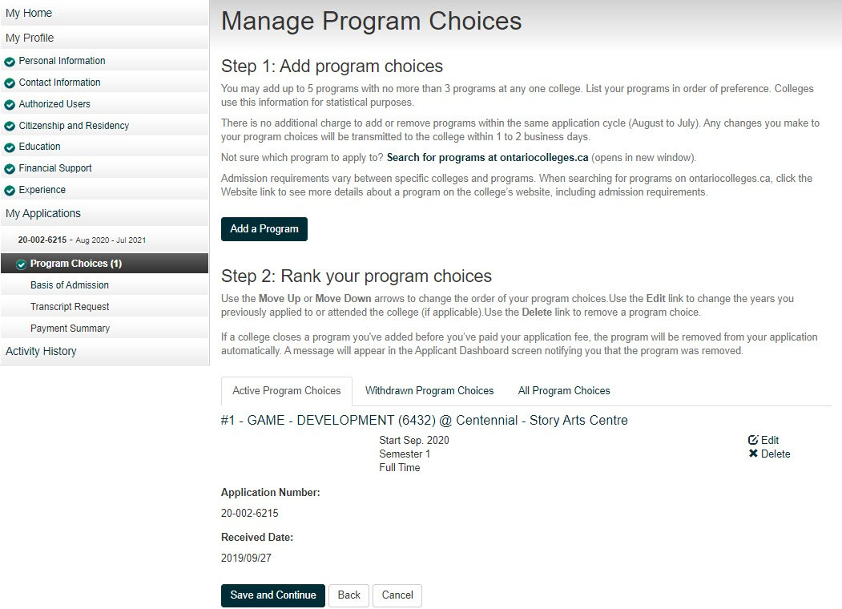
Program Choices
Manage Program Choices
Click the Add a Program button to add more program choices to your application.

Slide 54
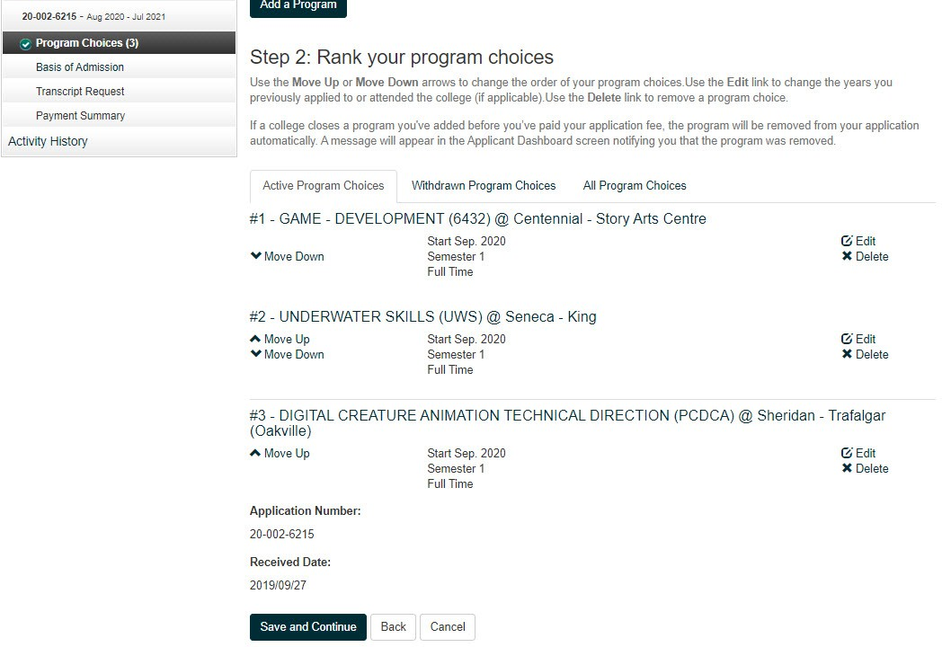
Program Choices
Rank Your Programs
Click Edit to change program information.
Click Delete to remove the
program from your application.
Use the Move Up and Move Down arrows to change the order of your programs.
Click Save and Continue.

Slide 55
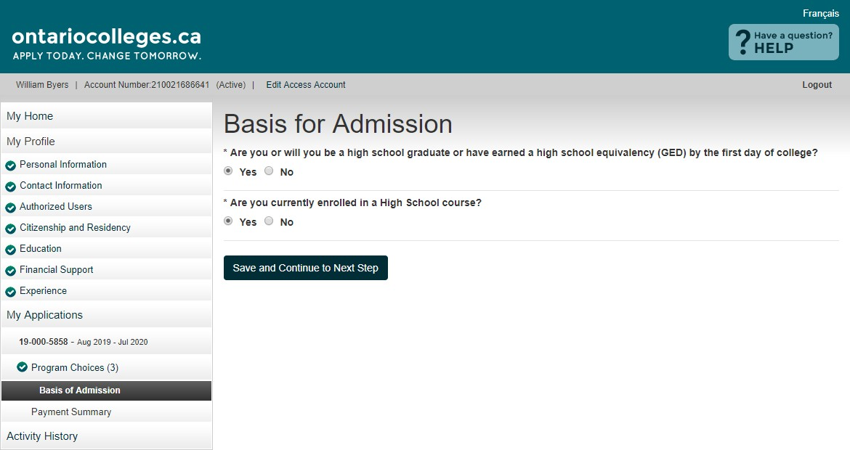
Basis for Admission
Review and answer both questions. Click
Save and Continue to Next Step when done.
Current High School Students:
Make sure Yes is selected for Question 2.

Slide 56
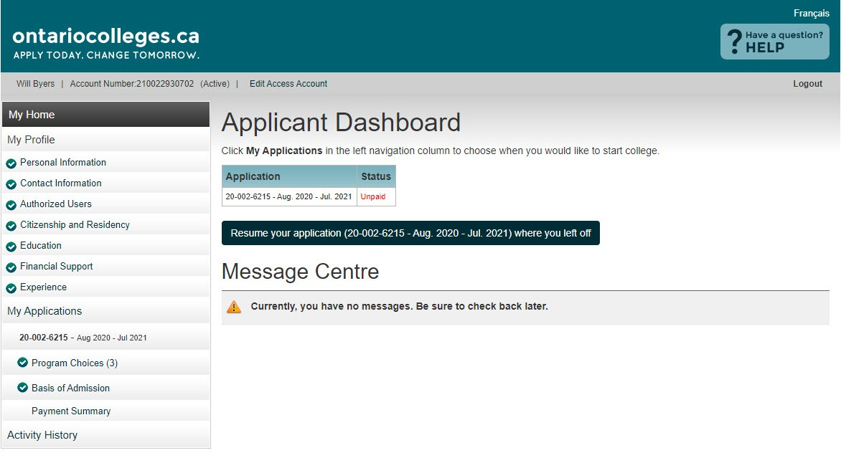
Applicant Dashboard
Application Status
Once program choices are added, the application status will be Unpaid.
After the application processing fee is received, the status is updated to Paid and your application information is forwarded to your college choice(s).

Slide 57
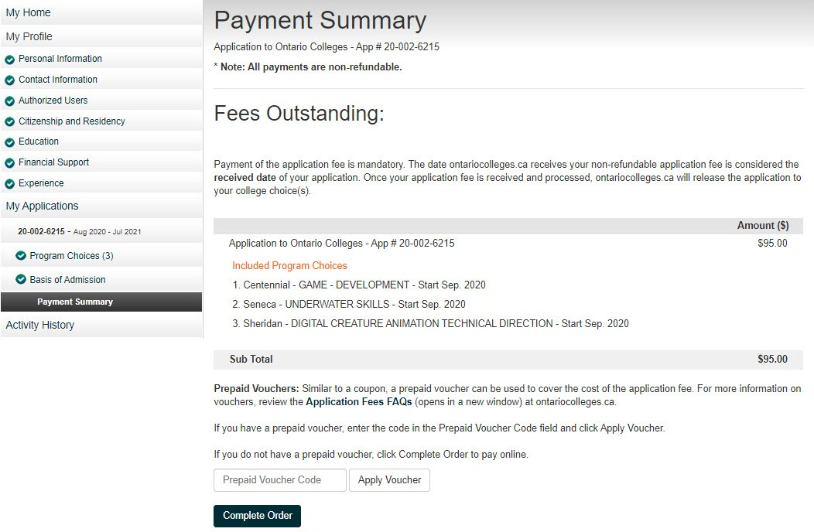

Payment Summary
Review your fees.
Click Complete Order to pay your application processing fee online.
$110
Prepaid Voucher Code
If you have a prepaid voucher code, enter it here and click Apply Voucher and wait for the page to refresh.
After the voucher code is applied you must click Complete Order to finish the process of applying the voucher.

Slide 58
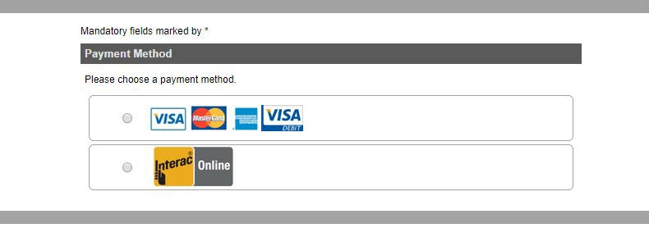
Secure Online Payment
Payment Method
Choose a payment method:
Credit card (including Visa Debit)
Interac Online

Slide 59
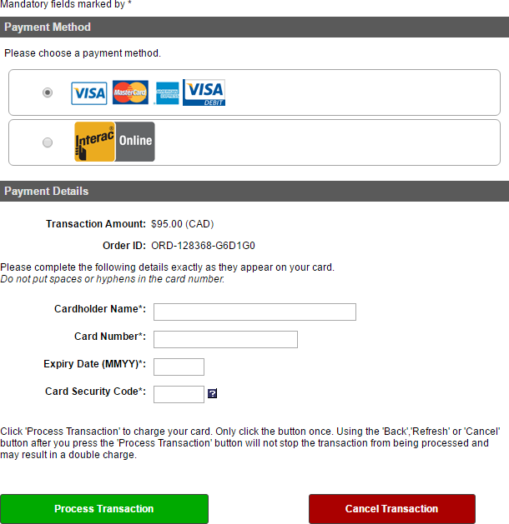
Secure Online Payment
Credit Card (including Visa Debit)
Payment Details
Enter your credit card details exactly as they appear on the card.
Card Number
Numbers only, no spaces or hyphens
Expiry Date
Enter the date using the format MMYY
Card Security Code
Visa / Mastercard – 3-digit code on the back of the card
American Express – 4-digit code on the front of the card, above the card number
$110
Click Process Transaction to complete your payment.
Note: Do not click the Back button in your browser while on the secure payment screen. If you do not wish to proceed with your payment, click Cancel Transaction.

Slide 60
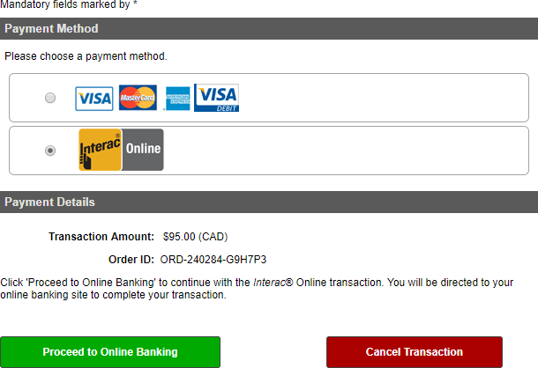
Secure Online Payment
Interac Online
$110
Click Proceed to Online Banking to
complete your payment.
Note: Do not click the Back button in your browser while on the secure payment screen. If you do not wish to proceed with your payment, click Cancel Transaction.

Slide 61
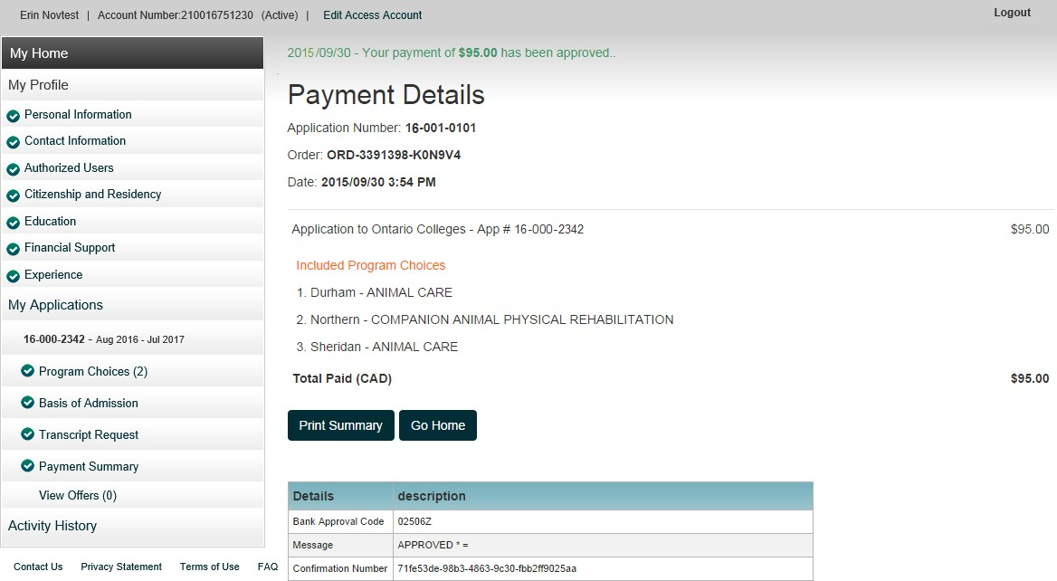
Payment Summary
Payment Details
Payment is verified on screen and you will be sent a confirmation email.
All payments are non-refundable
$110

Slide 62
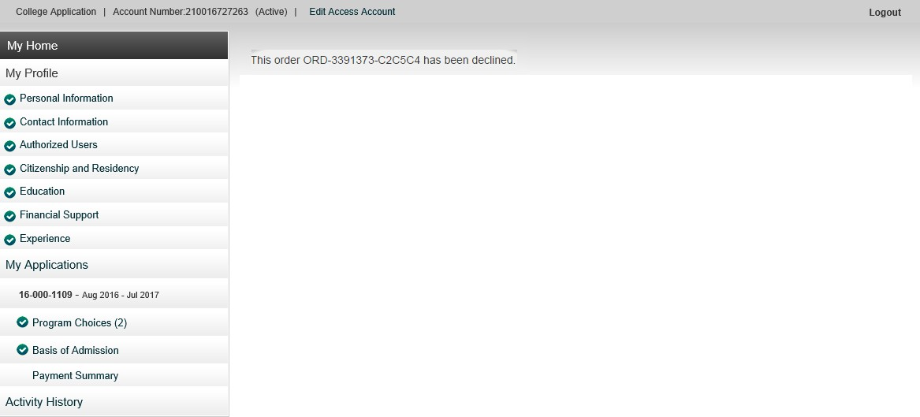
Payment Summary
Declined Payment
Declined Payment
A payment could be declined for a number of reasons,
including:
Incorrect credit card number or expiry date.
Insufficient funds on the card.
To try paying your fees again, click Payment Summary.

Slide 63
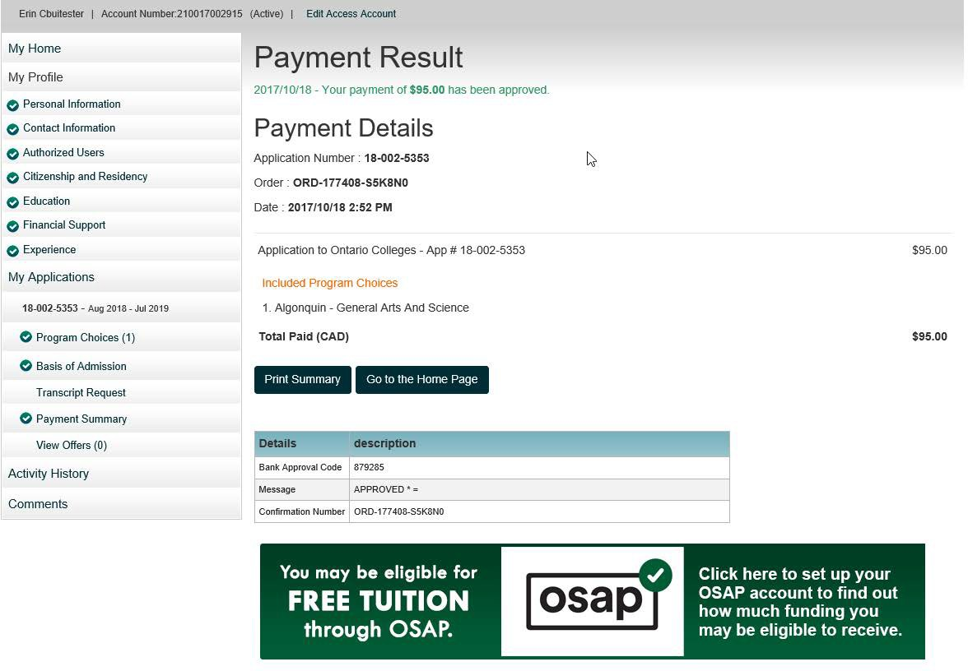
Apply For OSAP
$110
Ontario Residents
Click the OSAP banner to apply to receive financial aid from OSAP.
Your demographic information will already be filled out on the OSAP form based on what you entered on your college application.

Slide 64
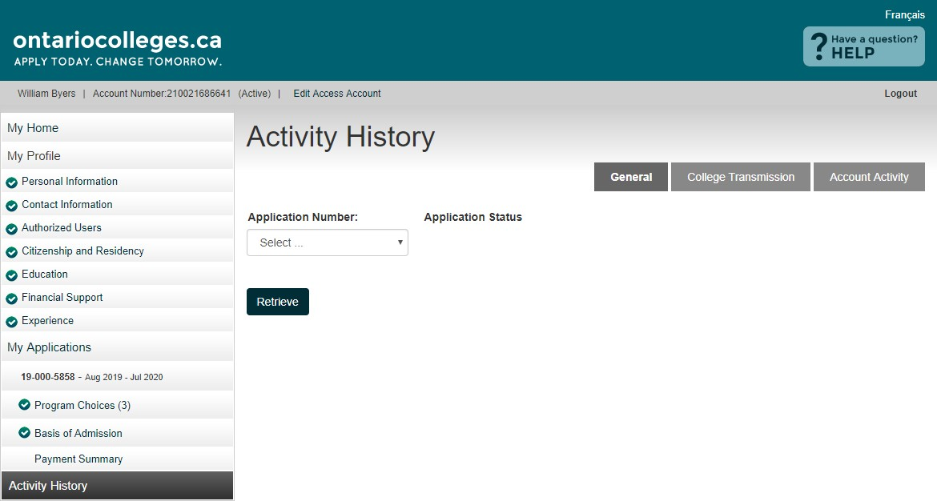
Activity History
General – Day-to-day summary
College Transmission – Summary of information that has been sent to your college choice(s). Not all documents will appear here. Updated nightly.
Account Activity – Summary of activity on your ontariocolleges.ca account
Select the application you wish to review and click Retrieve.

Slide 65

Activity History
General (Read Only)

Slide 66

Activity History
Account Activity

Slide 67
After You Apply – Next Steps

Slide 68
After You Apply
I’ve submitted my application. What’s next?
Verify your grades. If you’re a current Ontario high school student, you’ll need to log in to your account to verify your grades. We recommend checking the Education section after your mid-term and final marks for semesters 1 and 2 have been submitted. If you notice an error, report it your guidance counsellor.
Update your application. If you need to make changes to your application, such as adding or removing a program, or update your account information, such as your address or phone number, log back in to your ontariocolleges.ca account. ontariocolleges.ca/en/faq#how-can-i-make-changes-to-my-application
Confirm your offer. Colleges begin sending out offers on February 1. The following slides explain how to view and confirm offers of admission.
Apply for financial aid. Once you’ve confirmed an offer, it’s time to start thinking about paying for college. There are many financial aid options available to you, including OSAP, scholarships, bursaries and grants. To learn more, check out the Paying for College page: ontariocolleges.ca/colleges/paying-for-college and Maple’s Paying for Post-Secondary page found here.

Slide 69

Update Your Application
Remember to log out when you finish each session and clear your browser cache after you log out.
At any time you may resume your application from where you left off.
Once ALL sections are completed (as indicated by the checkmarks), you may return to each section to view or make edits.
Make sure you save any changes before moving to the next screen or logging out.

Slide 70

View and Confirm Offers
Click View Offers to see your offers of
admission.
Note: Offers can only be viewed after they are posted by the colleges.
Click Confirm Offer to accept an offer of admission. A confirmation
email will be sent to your email address.
You may accept only ONE offer at a time and you may accept only ONE offer in a 24-hour period.
Changing An Accepted Offer
If, after accepting an offer, you change your mind or receive another that you prefer, you may accept the new offer (before the expiry date). The new acceptance will cancel your previous one.

Slide 71
Apply From Your Phone

Slide 72



ontariocolleges.ca Mobile App
.
Create an application
Add programs to your application
Log in to your application
Request your
transcripts
Explore college programs
Pay for your application
Add programs to a Favourites list
View and confirm offers
Find it in the App Store and on Google Play

Slide 73

Apply Online

Slide 74

Thank you

Slide 75
Need Help?

Slide 76


Need Help?
For Application Help:
Click FAQ to find answers to common questions
Chat with us in real-time by clicking the Live Chat button on the ontariocolleges.ca website
Email us at ask-us@ontariocolleges.ca
Call us at 1-888-892-2228
To Correct High School Grades:
See your guidance counsellor
For Offer of Admission Information:
Contact the college(s) you’ve applied to
Connect With Us: facebook.com/ontariocolleges.ca @ontariocolleges
www.ontariocolleges.ca
•
•

